Slide 1

F1 Racing
A high level look at the history of F1 from 1950 to 2024
By: Marta Baker, Kevin Carney, Katie Rebeck

Slide 2
Purpose
The purpose of our project was to give a high-level analysis of data pertaining to the F1 series of circuits to give a glimpse into not only the locations of the circuits, but to observe how each respective country / driver has been performing.
Furthermore, we looked at the number of races that drivers have driven for each constructor.

Slide 3
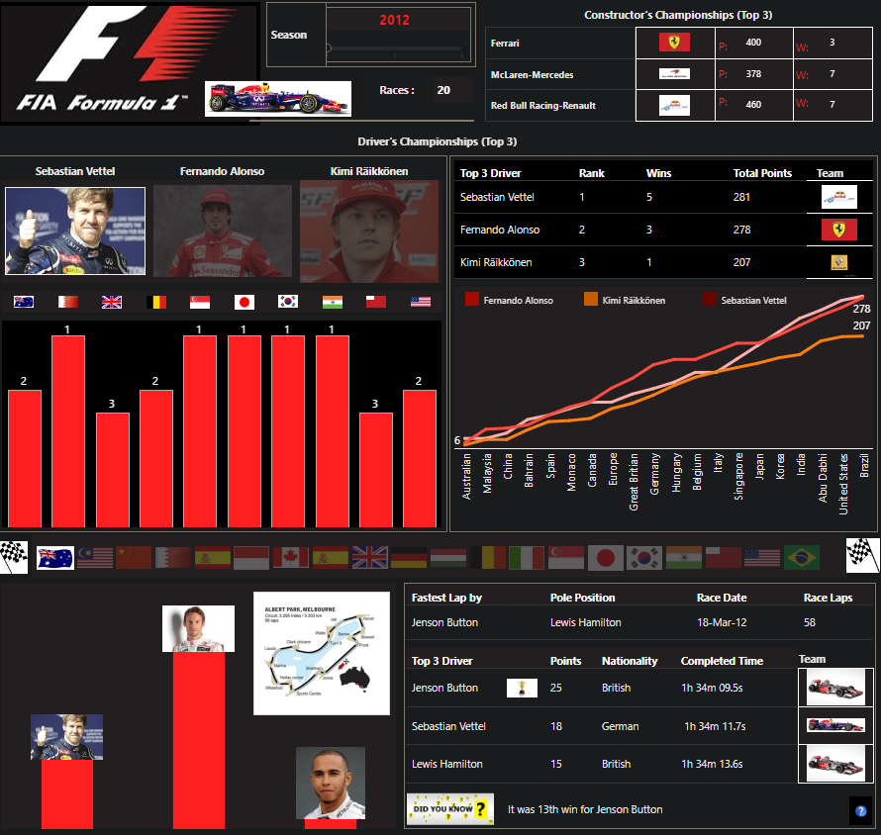
Inspiration
Additional Internet Resources to Reference:
https://public.tableau.com/app/profile/panki.shah/viz/Formula1_0/Formula1
https://www.formula1.com/en/results/2024/drivers
https://racingnews365.com/formula-1-circuits
Additional Datasets
https://www.kaggle.com/datasets/cjgdev/formula-1-race-data-19502017 - Formula 1 Race Data by Chris G
https://www.kaggle.com/datasets/jtrotman/formula-1-race-events – Formula 1 Race Events by James Trotman
https://www.kaggle.com/datasets/cbhavik/formula-1-ml-classifier - Formula 1 Race Data by Bhavik Chandna

Slide 4

Design Concepts
One place where our design concepts came from was the F1 website itself. It contains a lot of great information for anyone who wants to learn more about what F1 is and how it operates.
Inspiration points:
Overall appearance using the F1 color scheme
General layout of the navbar
Queries of interest for casual audiences

Slide 5
Research Questions
Question 1: Where are all the circuits located? We used a map with pins to demonstrate where all the different circuits are located
Question 2: In terms of first place finishes, how have each of the different nationalities performed.
Question 3: What is the most recent constructor that each driver has driven for.

Slide 6
Live Demo
Now we’ll be doing a live demo by Marta Baker.
This will involve a tour of the app and the visualizations that help to show our code.

Slide 7
Conclusions
The country with the most F1 circuits is: The United States
The nationality of the driver with the most 1st place finishes is:
Lewis Hamilton - British
For all nationalities, the drivers with the largest number of 1st place finishes are:
Lewis Hamilton – Current Constructor: Mercedes – 104 1st place finishes
Michael Schumacher (Retired) – Most Prolific Constructor: Ferrari – 91 1st places finishes
Max Verstappen – Current Constructor: Red Bull – 61 1st place finishes

Slide 8
Limitations
This dataset was particularly large, containing the information from all the races from 1950 to 2024. The time limitations for this assignment meant that more queries couldn’t be pursued. There are so many potential relationships to explore.
Bias
This dataset consisted of information that is monitored and recorded based on performance in a structured event. While the bias may be limited there is missing results from earlier races which could potentially skew the data based on the queries that are pursued. Were there any additional bias it would likely extend more to calls and analysis made by the stewards of the races rather than this dataset.

Slide 9
Future Work
There could be some additional points of interest in doing a deeper dive into the years themselves to observe any notable streaks of improvement in the standings of different drivers for the various nationalities.
It would also be interesting to see if there was a particular race that had surprising developments. Constructors that tended to have lower finishes having a higher finish and the circumstances that might’ve led to it. There is a tendency for higher placing constructors to remain in their positions due to the greater overall financial backing that said constructor might receive due to their performance.
Did “home turf” races yield better results for the drivers that were from the country where that circuit was located.

Slide 10
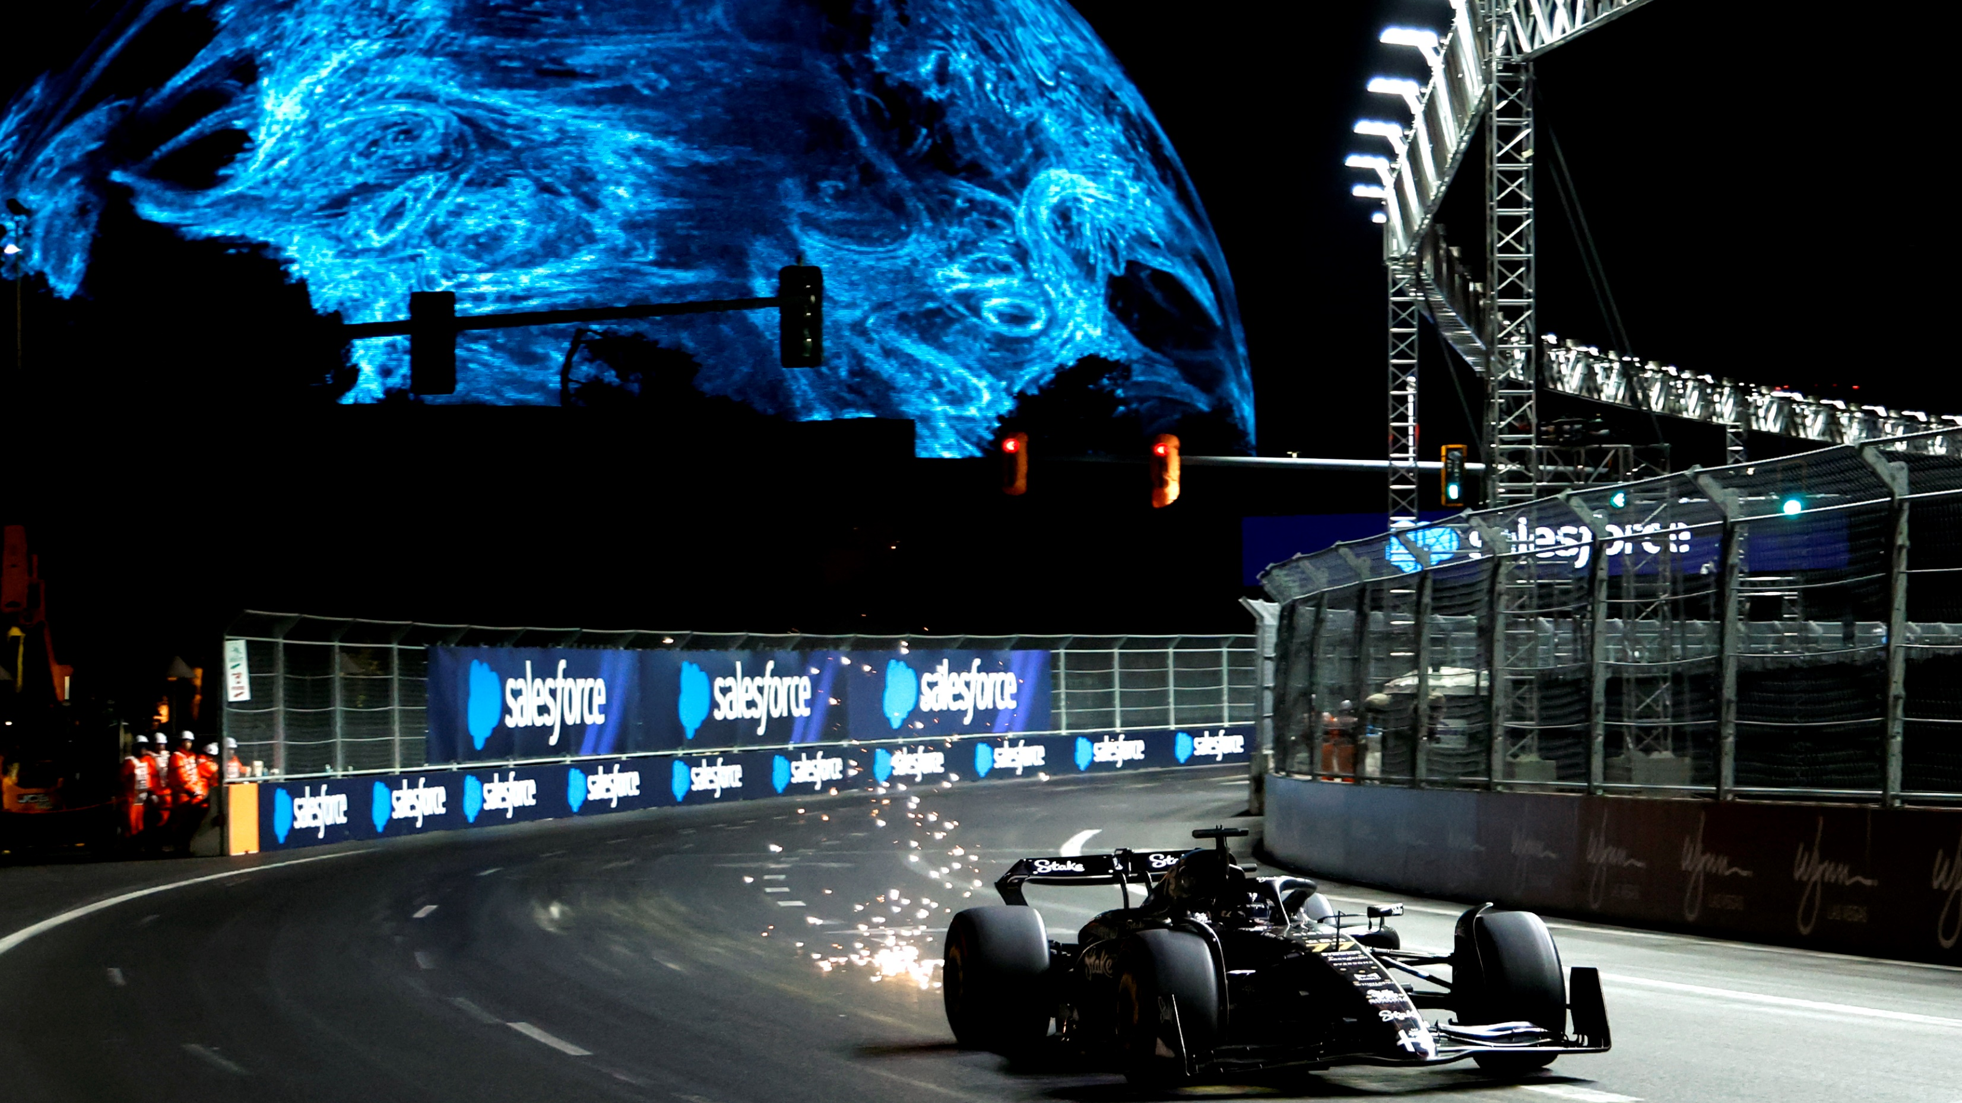
Questions?

